Slide 1
CrowdPower: Events/Crowds
Dartis Willis
Cristian Lara
Neven Wang -Tomic

Slide 2
Initial P.O.V.
“We met both event organizers and attendees at three distinct events. We were amazed to find there is a “sweet spot” crowd size that enhances the experience of an event. It would be game changing if we could make users feel knowledgeable about crowd size.”
This P.O.V. is too superficial!
(Let’s go deeper)

Slide 3



Additional Needfinding: Jenny Lu
Attends many events Maintains active social life
Considers herself an “expert” on the subject

Slide 4
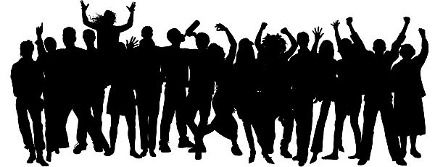
With deeper analysis we found...
Additional information/rules about sweet spot
The sweet-spot concept is built on deeper human behavior.
Our LEAP was: Experiencing events with others provides for many inherent human desires.
Needs: To satiate the desire to enjoy things in groups, and to be informed about opportunities to do so

Slide 5
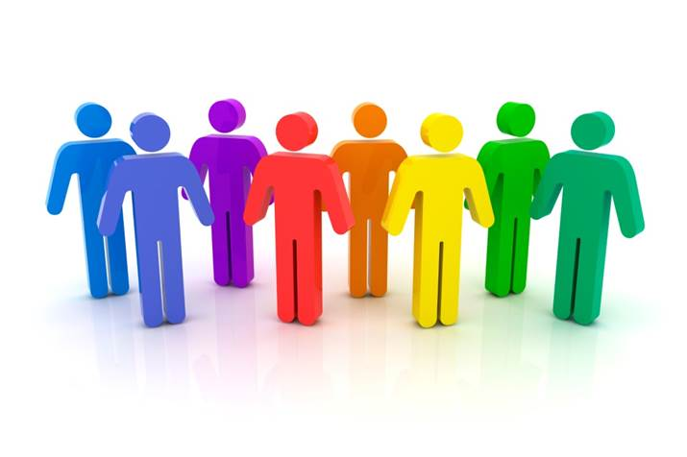
Revised P.O.V. #1
We met event goers at three distinct events,
We were surprised to find that satisfying the primal desire to enjoy experiences in a group largely defines how much people enjoy an event.
It would be game changing if we could enhance these “satisfying” group experiences before, during, and after an event.

Slide 6
Revised P.O.V. #2
We were surprised to find the amount of emphasis that people put on inferred guesses to best utilize the time and emotions they invest into events. (See desires from POV #1)
It would be game changing if we could reliably provide information that would improve the time people spend at events and save them from unsatisfying experiences.
People are surprisingly upset when expectations of events do not translate to reality.

Slide 7
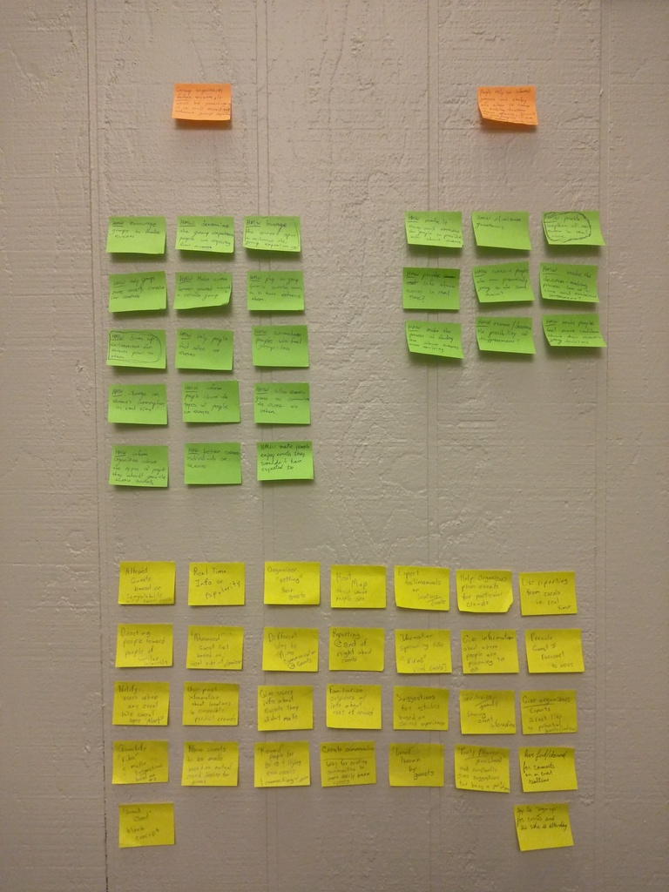

How might we...
Drum up excitement for events prior to their occurrence
Stems from the first P.O.V in that collective excitement builds up the group experience

Slide 8
How might we...
Provide snapshots of what an event is like in real-time
Stems from the second P.O.V in that providing people with media and information from events aids in the decision making process..

Slide 9
How might we...
Expand positive group feeling beyond the duration of the event.
Stems from the first P.O.V in that people value the group feeling they get from social events, extending this would give people something to look back on.

Slide 10
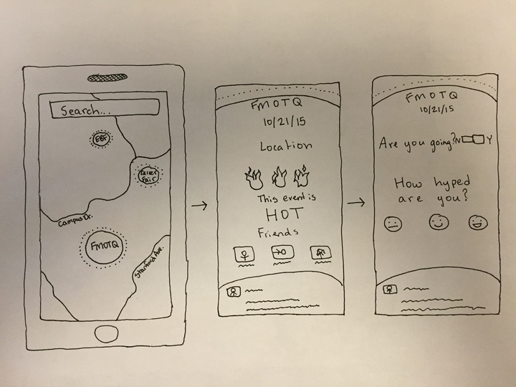
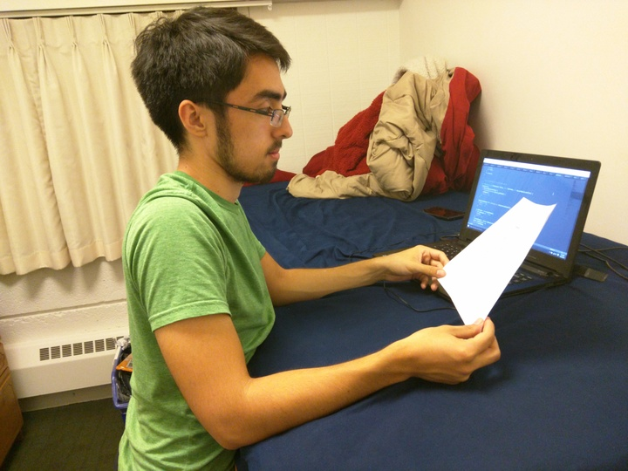
Experience Prototype #1 “Bubble Map”
Description: Bubble map of nearby events showing their immediate popularity
What worked?
The “hotness” meter
Map Representation
What didn’t?
False events being created
Unreliable event time reporting
Survey-esque questions
Surprises? New Learnings?
It would be difficult to implement for small events
How can we tell if an event’s plans change?
Main Assumption Validity? Valid
Seeing location based visualizations of events is a valid desire

Slide 11
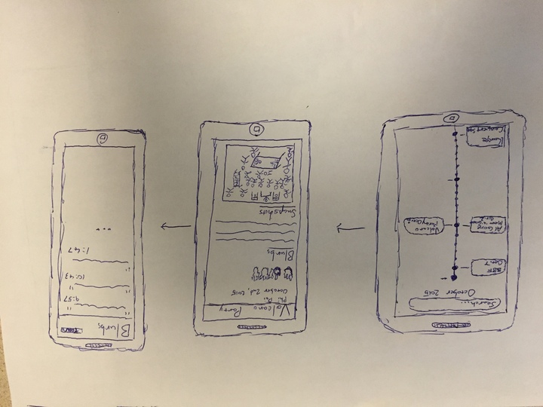
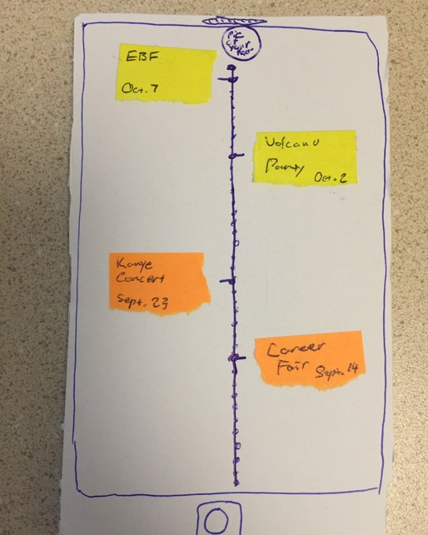
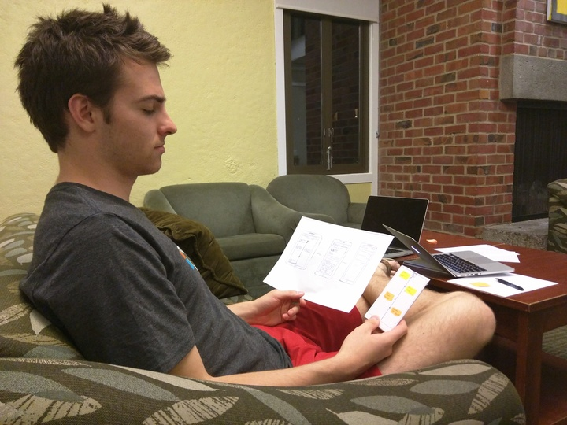
Experience Prototype #2 “Timeline”
Description: Timeline keeping track of past events attended
What worked?
Timeline Format
Blurbs method of documentation
What didn’t?
Uploading directly to app is inconvenient
Separated blurbs and snapshots
Surprises? New Learnings?
Images enhance experience
Main Assumption Validity? Valid
People want a social record of events they have attended

Slide 12
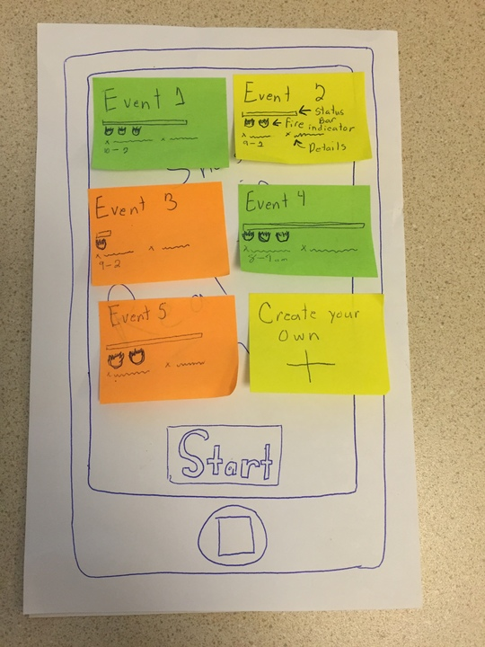
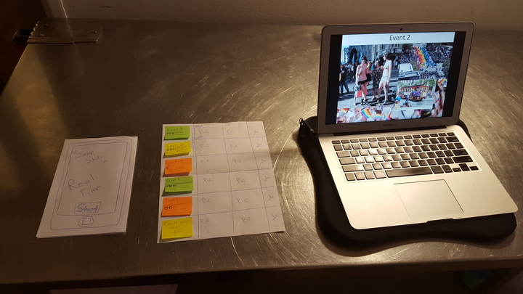
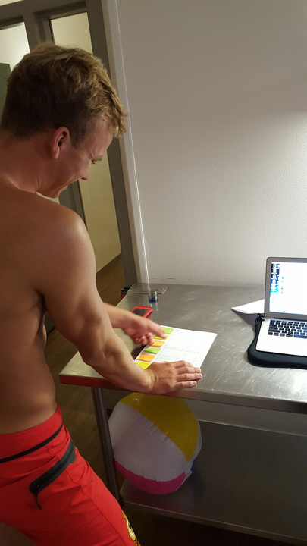
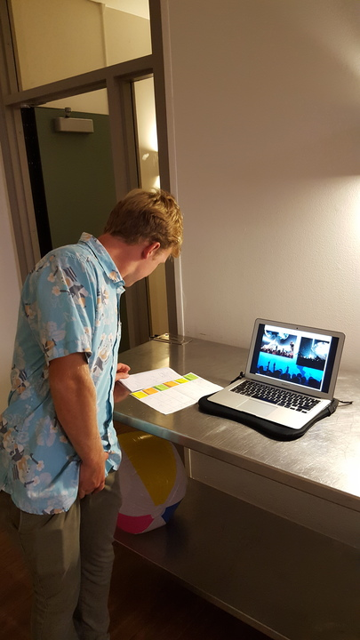
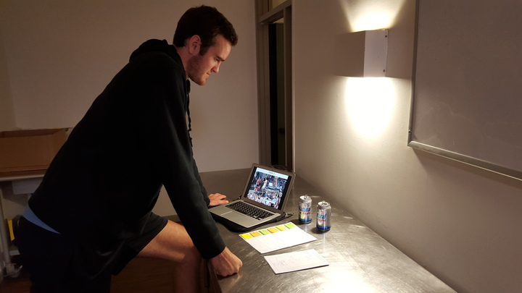
Experience Prototype #3 “Real-Time Update”
Description: Live feed of events with supplied pictures for each event.
What worked?
Potential for “wide” selection of events
Incentive to upload pictures
What didn’t?
Security
Inclusion of friends
Surprises? New Learnings?
High “forgiveness” for app/experience failure
Main Assumption Validity? Valid
People are willing contribute to/use crowd sources of information about events they attend.

